Slide 1
Automating Power BI Governance: How dynamic security groups can solve 95% of your sharing needs
Bernat Agulló

Slide 2



Speaker
Bernat Agulló Roselló
Data Platform MVP since Agust 2022
Partner at BI Firm ESBRINA (Barcelona)
esbrina-ba.com/blog
@AgulloBernat

Slide 3




John moves from Finance to Sales
Hi! I’m now in sales, can you give me access to the Sales Reports?
I have a ton of other stuff to do actually
Sure thing!
Finance Reports
Sales Reports
Sales Reports Admin
Finance Reports Admin
John

Slide 4
John moves from Finance to Sales
Please remember to remove my access to Finance reports!
NOT GOING
TO HAPPEN
Finance Reports
You got it!
Sales Reports
Sales Reports Admin
Finance Reports Admin
John

Slide 5
Sharing with users
We need to keep maintaining the list of users as new people join the organization, or move departments
Most of the time only add new permissions, nobody has time to review existing permissions

Slide 6

“don’t share with users, share with (static) security groups”
Common advice:

Slide 7
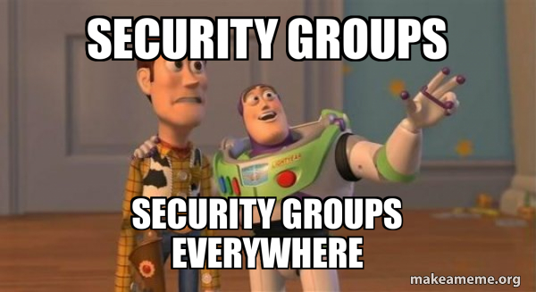
SG_CORP_PRO_ADMIN
SG_CORP_PRO_ADMIN
SG_CORP_PRO_ADMIN
SG_CORP_PRO_APP_TOP_REPORTS
SG_WS_CREATORS
SG_CORP_APP_DETAIL_REPORTS
SG_TENANT_DEV
SG_CORP_APP_DETAIL_REPORTS
SG_TENANT_PRO
SG_SALES_MODEL_BUILD
SG_CORP_TEST_MEMBER
SG_SALES_MODEL_READ
SG_CORP_TEST_ADMIN
SG_CORP_DEV_ADMIN
SG_DEPLOY_CORP

Slide 8

John moves from Finance to Sales
Hi! I’m now in sales, can you give me access to the Sales Reports?
Not again! I hate opening JIRA tickets
It will take a couple days
Finance Reports
Sales Reports
JIRA Guy
Sales Reports Admin
Finance Reports Admin
John

Slide 9
John moves from Finance to Sales
Can you remove me from the security groups that are giving me access to Finance Reports?
NOT GOING
TO HAPPEN
BUT EVEN IF IT DID IS NOT EASY
Maybe tomorrow
Finance Reports
Sure...
Sales Reports
Sales Reports Admin
Finance Reports Admin
John

Slide 10
Sharing with static security groups
Static security groups add overhead when sharing (i.e. JIRA tickets) and make it hard to understand who has access to what.
Artifact-based security groups are hard to manage for the large number of artifacts and permission levels

Slide 11
Why do we share?
Do we share because the name people have? No.
Or do we share because the role people have in the organization? Totally.
The department of an employee is a rough proxy of his or her role.

Slide 12
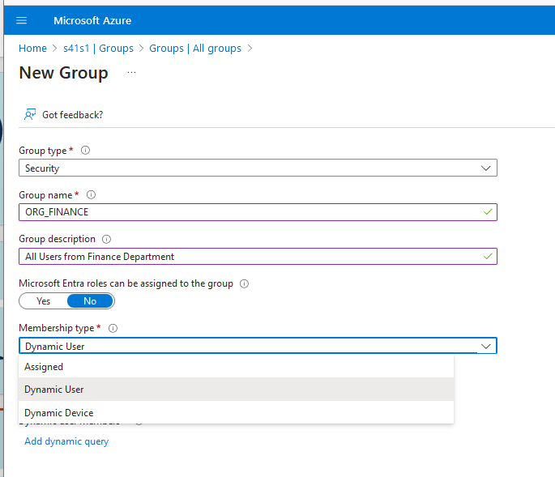

Dynamic Security Groups!
A dynamic security group is a security group with a membership type configured as “Dynamic User”
This dropdown is greyed-out for “P1 free”. Entra ID Paid P1 or P2 are required for this feature

Slide 13
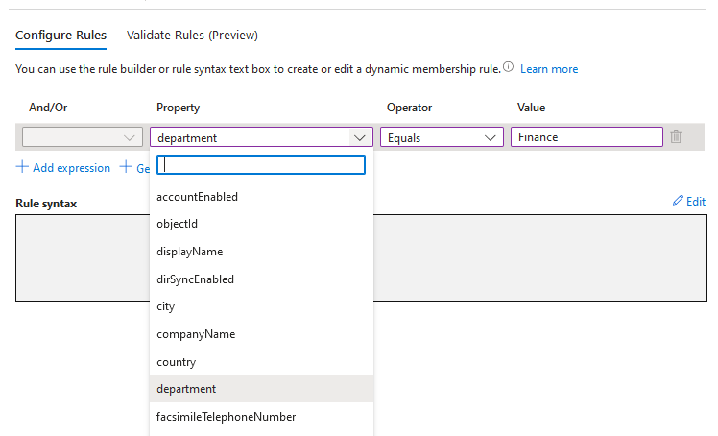
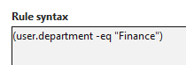
Dynamic Security Groups!
Membership is defined through an expression over the user attributes in Entra ID

Slide 14
Dynamic Security Groups!
There is already a department with the task of maintaining employee metadata: ***The HR department***
We just need to validate that the org-related information from HR is clean and travels to Entra ID in a timely fashion

Slide 15









Ensure you have good metadata
?
HR
Active Directory (On-Premise)
Staff.xlsx
Entra ID (Azure)
Org.xlsx
UserName, DisplayName, Department, Company, Position...
=
Graph API
?
AllUsers.json

Slide 16
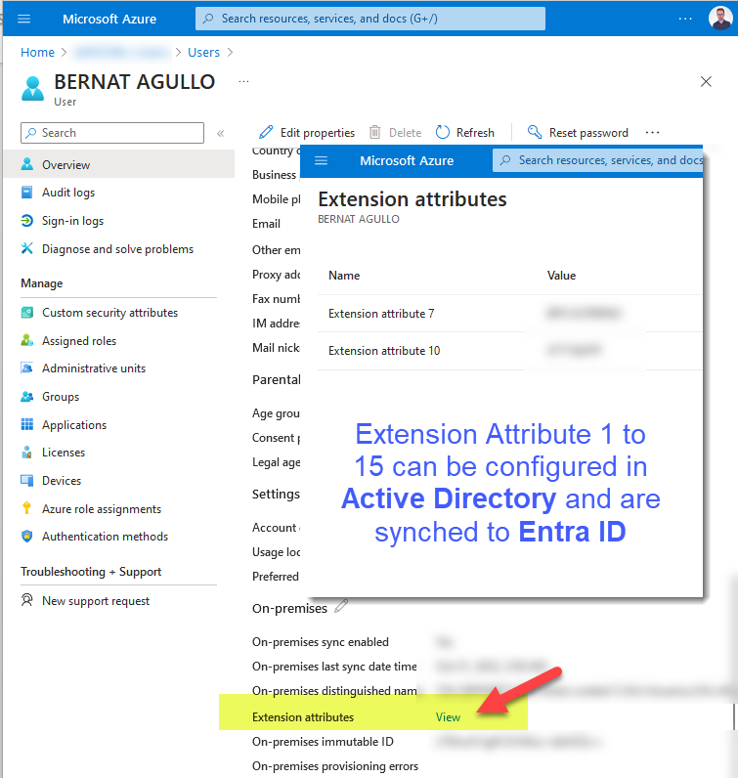
Ensure you have good metadata
Graph API
Entra ID (Azure)
AllUsers.json
$select=id,mail,companyName,department,displayName,userType,UserPrincipalName,jobTitle,onPremisesExtensionAttributes,accountEnabled,employeeOrgData,onPremisesSamAccountName

Slide 17
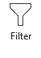

Compare tables
Something not working on the excel to Active Directory sync
Check Ids
Check Attributes
Users only in Excel??
User | Attribute | Excel | Entra ID | Chk
john@tech.com | Department | Sales | Finance | ❌
john@tech.com | jobTitle | Pre-Sale specialist | Portfolio Analyst | ❌
clair@tech.com | department | Operations | Operations | ✅
clair@tech.com | jobTitle | Director | Director | ✅
Matching users
Users only in Entra ID??
Active
Employee
email or samAccountName
Differences in displayName are OK. Not everyone wants their legal name in Outlook (Bob vs William etc)

Slide 18

Create Dynamic Security Groups
Group Name
Rule Syntax
Create the groups that make sense to your Organization
Start with departments, and go smaller if you need to.
If needed you can use the 15 Extension attributes
Programs like ADManager Plus can help keep Active Directory in sync with HR data
SG_SALES
user.department -eq “Sales”
SG_DIRECTORS
user.jobTitle -eq “Director”
SG_FINANCE_ANALYST
user.jobTitle -eq “Finance” and jobTitle -eq “Analyst”

Slide 19
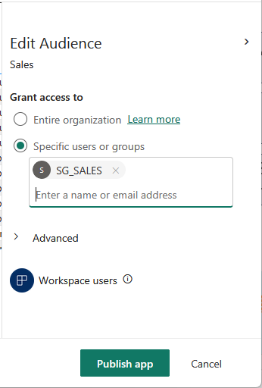
Set and forget
Only employees with “Sales” as department get access.
If somebody from Sales cannot access, they need to speak with HR to fix the Active Directory (or get a Pro licence…)

Slide 20

John moves from Finance to Sales
Hi! I’m now in sales, can you give me access to the Sales Reports?
Did you even try to access??
You already have access, honey!
Finance Reports
Sales Reports
Sales Reports Admin
Finance Reports Admin
John

Slide 21
John moves from Finance to Sales
Can you remove me from the security groups that are giving me access to Finance Reports?
NOT GOING
TO HAPPEN
BUT IT WOULD BE LIKE THIS
This is so cool
Finance Reports
Actually this already happened
Sales Reports
Sales Reports Admin
Finance Reports Admin
John

Slide 22

Demo time!

Slide 23
Q&A
How do I handle exceptions?
Adding directly users that fall out the regular pattern is easier to read and understand that this is an exception
What about external users?
These are normally not handled by HR. Still, finding a process to fix their metadata will save a lot of pain if they need to get access often.

Slide 24
Q&A
How can I let people know who is in each group?
Build a report with Graph API data on groups
groups?$select=id,displayName,description&$filter=startsWith(displayName, ‘SG_')
groups/{groupId}/members
What if I HR data is unreliable or there is not a single source of truth?
Stay away from this approach

Slide 25
Q&A
Wait, what’s the catch?
No catch, is like magic. You only need to fear some Organization-wide renaming of the departments ☠️. Such a change needs to be planned with HR so that people do not loose access
Static Security Groups have any use at all then?
Of course! Not everything can be handled on Entra ID, but if possible, define a group owner with access to Entra ID so we don’t spend our days on JIRA. Try to make groups Role oriented if possible and not feature/artifact oriented

Slide 26
Resources
Material:
esbrina-ba.com/rethinking-security-groups-for-power-bi/
justb.dk/blog/2022/04/extracting-microsoft-graph-data-with-data-factory/
Images:
http://www.icons-land.com/
https://www.iconarchive.com/

Slide 27
Let’s connect
Bernat Agulló
bernat.agullo@esbrina-ba.com
https://www.linkedin.com/in/bernatagullo/
https://twitter.com/AgulloBernat

Slide 28













